Slide 1
IBM HR Project

Slide 2
Introduction
Work is a hot area. More and more people care about how they can be selected by the company among many competitors. So we choose this topic and want to find the factors when a company or HR hiring employees.
The company we choose which is called IBM company,this company is a global technology company, and this company contains many data and attributes which fit our topic.

Slide 3
Introduction
A major problem in high employee attrition is its cost to an organization. And we use monthly income and job position these two variables to predict and even reduce this problem .
We use some models to help us, we use linear regression model, logistic regression model, boosted decision trees, bootstrap forest, neural networks. And we compare these models to find the best model to help us predict the employee attrition.

Slide 4
Target Variable Choice
Data Refinement

Slide 5
Reasons for Y variables
The goal for IBM company is reducing the cost
The attrition of previous and current employees can help
The monthly income would be the key variable will affect cost

Slide 6
Reasons for data refinement
Variables need to get rid of
Highly correlated variable: Possible to be target leakage
Meaningless variables: No help to understand target variables
Variable type can change

Slide 7
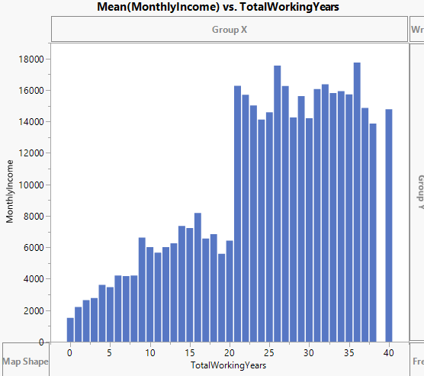
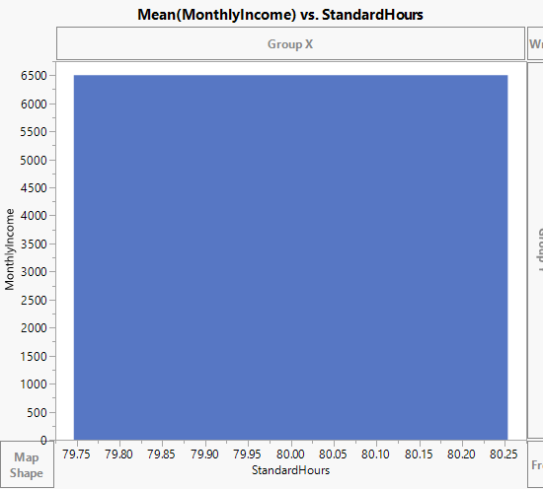
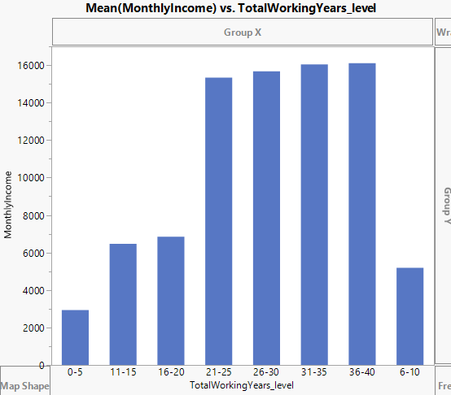
Variables from raw dataset

Slide 8
Model with Different Y Variables
Monthly Income
Attrition

Slide 9
Understanding monthly income
Very strong correlation with Job Rate and Job Role
Target leakage or just strong predictor?
Is it known?
What is Job rate?
Associate Technician, Technician, Senior Technician, Staff Technician,...?
Simply Pay-ranges?
A few models were built including these out of interest Rsquare rose from 0.70 range to 0.95 range.
Decision: don’t use

Slide 10
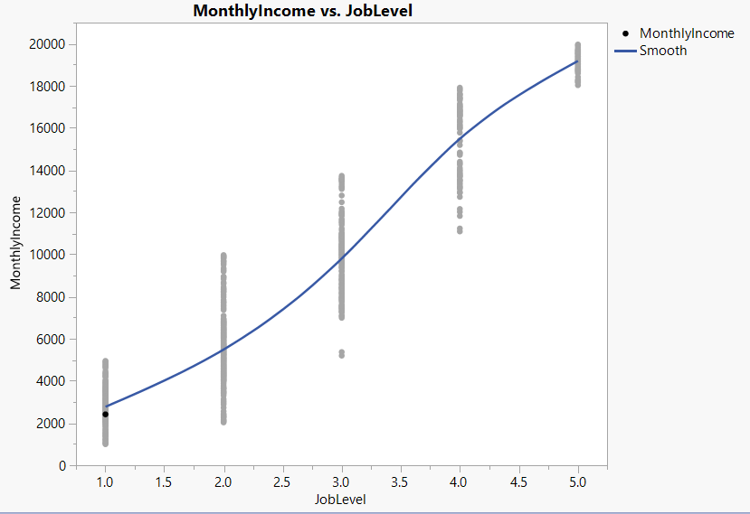
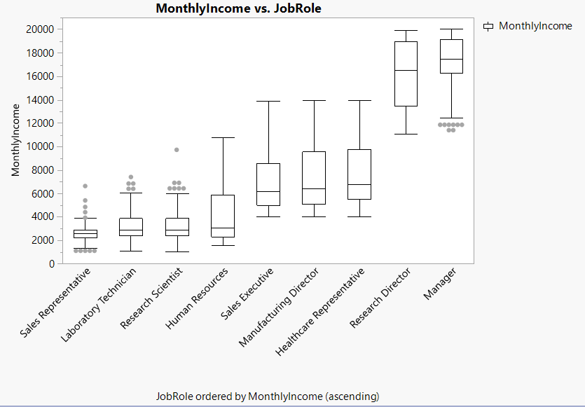
Understanding monthly income

Slide 11
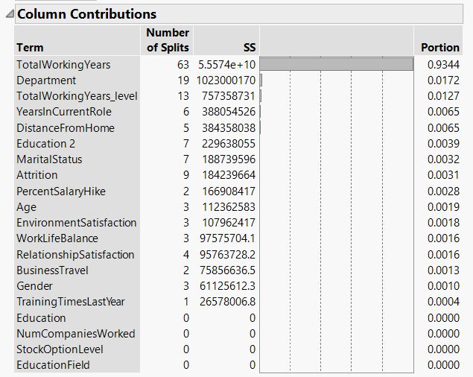
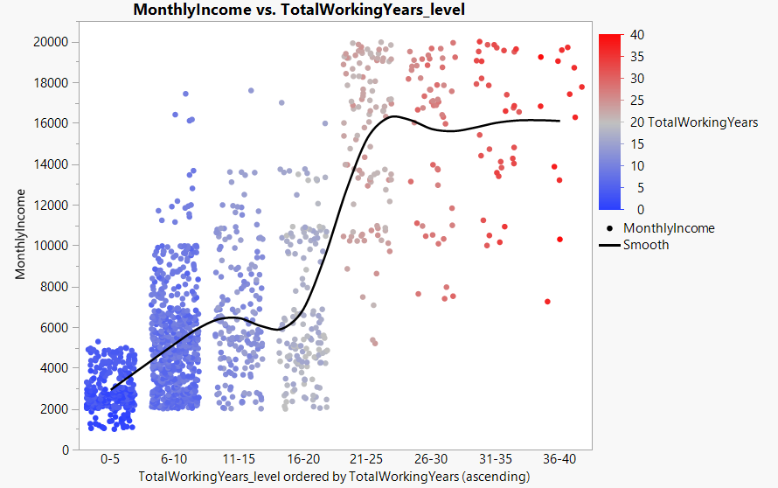
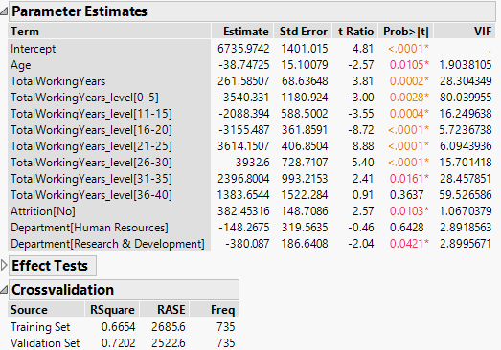
Models predicting monthly income
Total Working Years
Favorite split on Trees
Low Prob>|t|
Best model has TWY as continuous and categorical

Slide 12
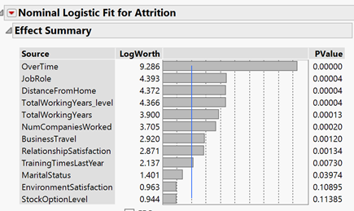
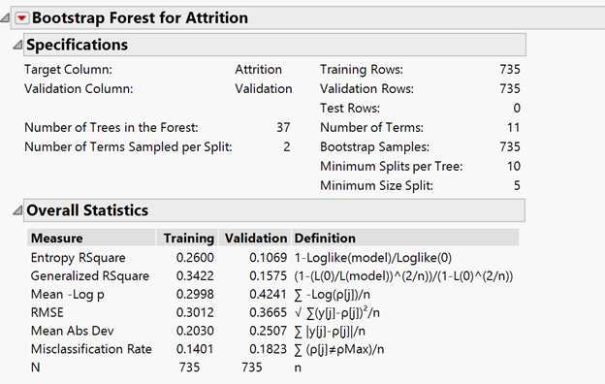
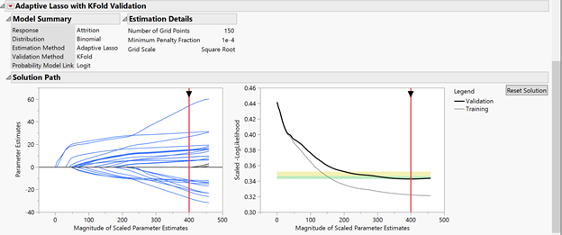
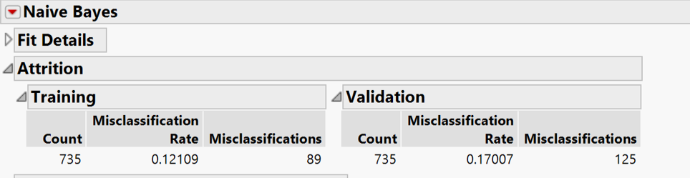

Slide 13
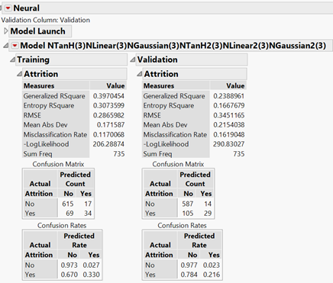
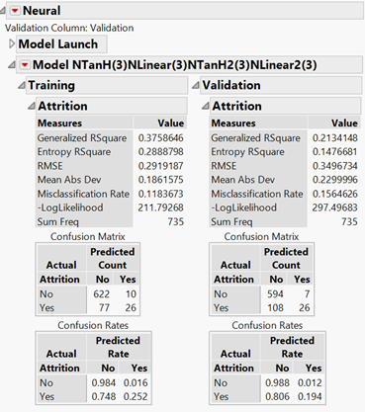
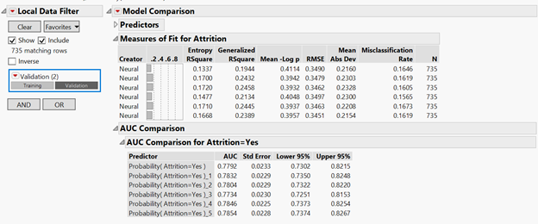
83.809%
84.35%

Slide 14
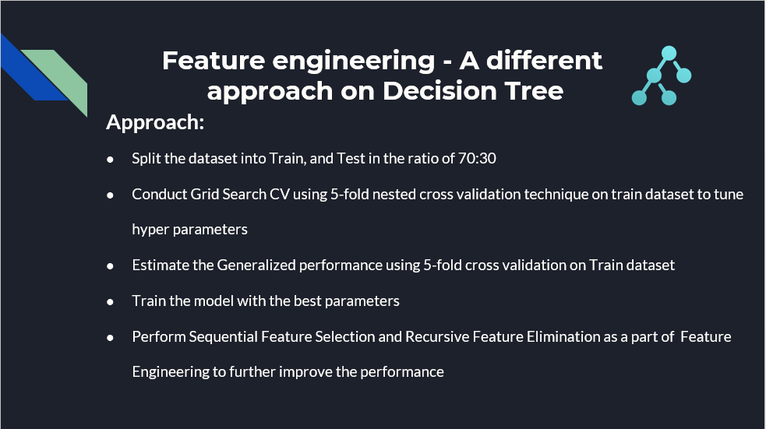
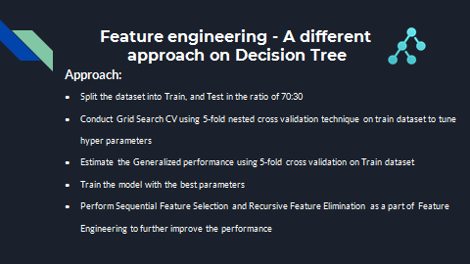

Slide 15
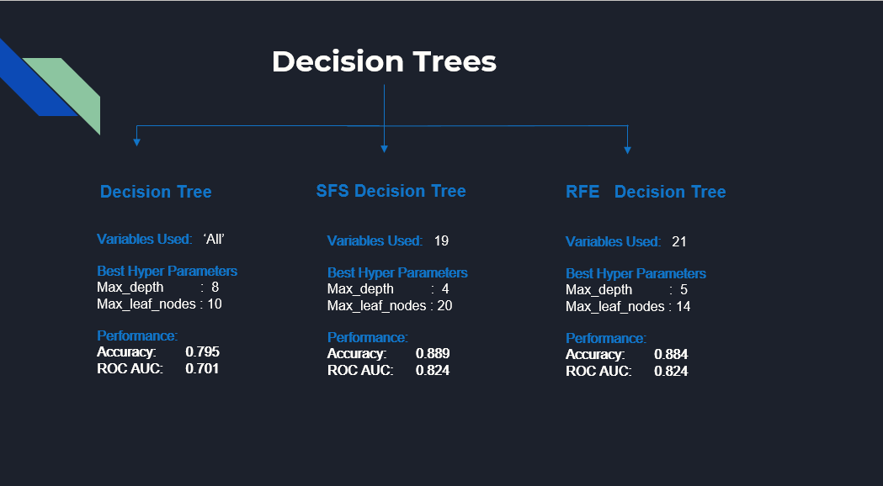

Slide 16
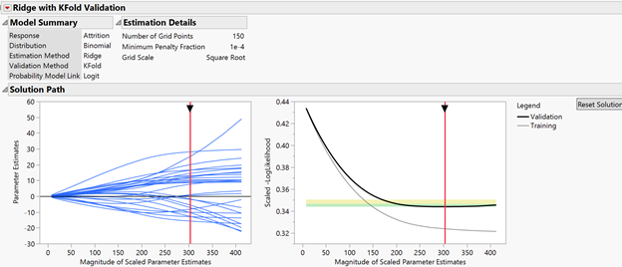
Best Model

Slide 17
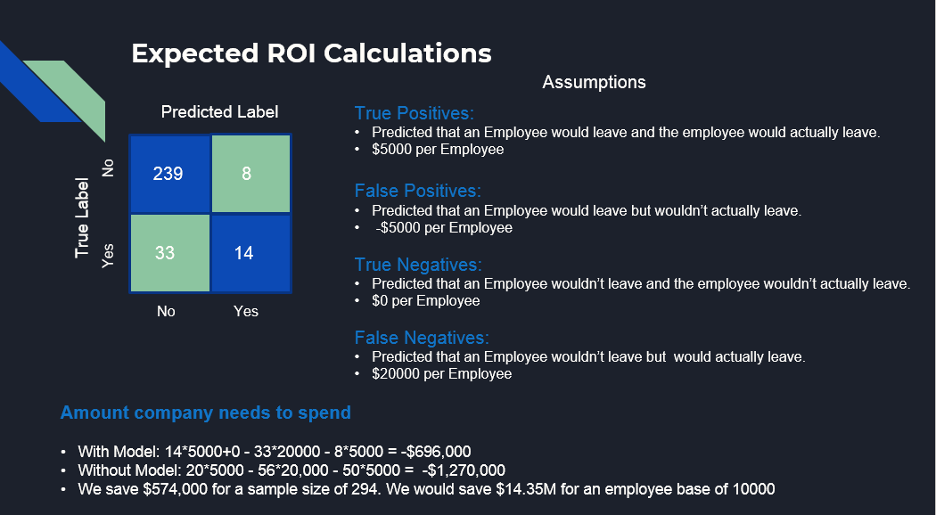

Slide 18
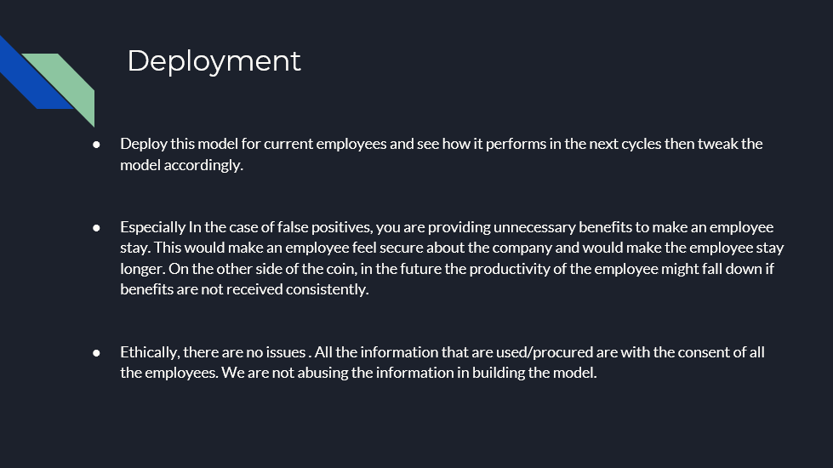

Slide 19
Business Insights and
Recommendations

Slide 20
Recommendations:
We found that employees from the sales department have the highest attrition rate = 30%
Also the job role Sales Representatives has the highest attrition rate ~ 40%
From the contingency analysis of attrition by Marital status, it was observed that Singles have a high attrition rate (25%) compared with the married and divorced people. And practically it makes sense too.
The variables Performance ratings and Percent Salary Hike are highly correlated. The better the performance rating the better is the percent salary hike.
Senior employees with around 15 years of work experience have very less attrition rate. So it can be inferred that experience adds stability to the job.
If an employee has worked for more than 8 companies than the chances of leaving the company are maximum those employees.
According to the model, we find that monthly income correlated with Totalworkingyears positively, also neural net model did not outperform compare with other models

Slide 21
Backup

Slide 22
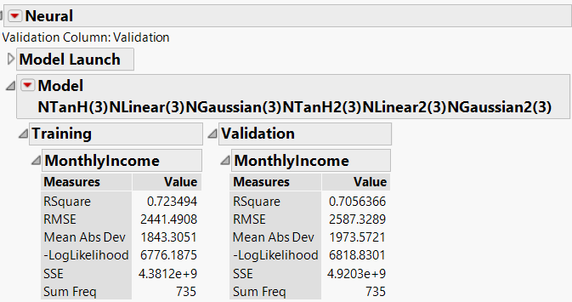
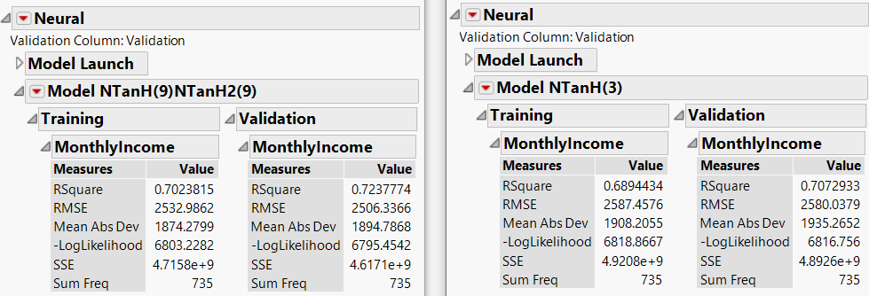
Models predicting monthly income
Neural Net- weak model
RSquare values .7056 - .7238
Linear Regression was ~.72
“Black Box"
Recommendation: Don’t use NN

